Slide 1




Home
Service
About Us
Contact
DEEP RACER
4109053049 張康磊
4110053037 王盈穎

Slide 2
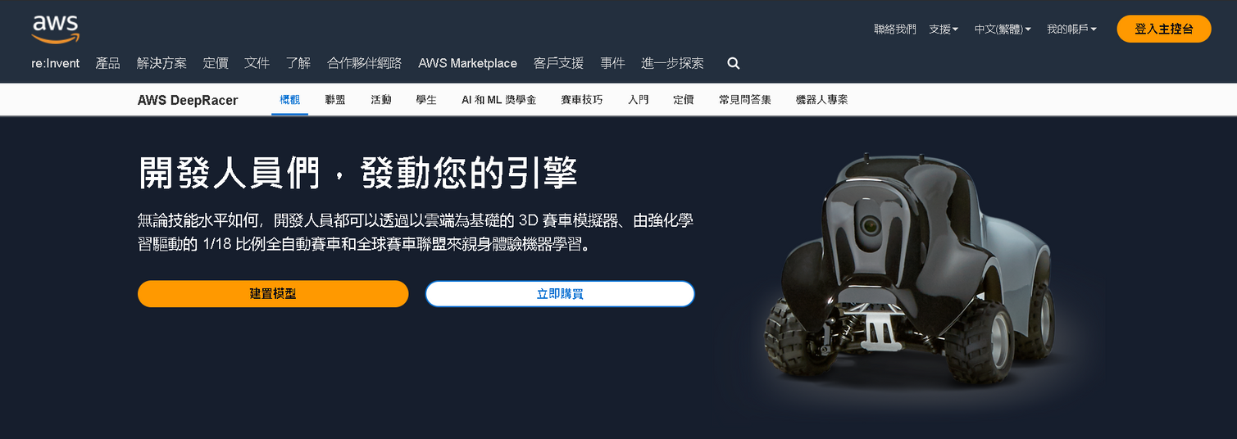
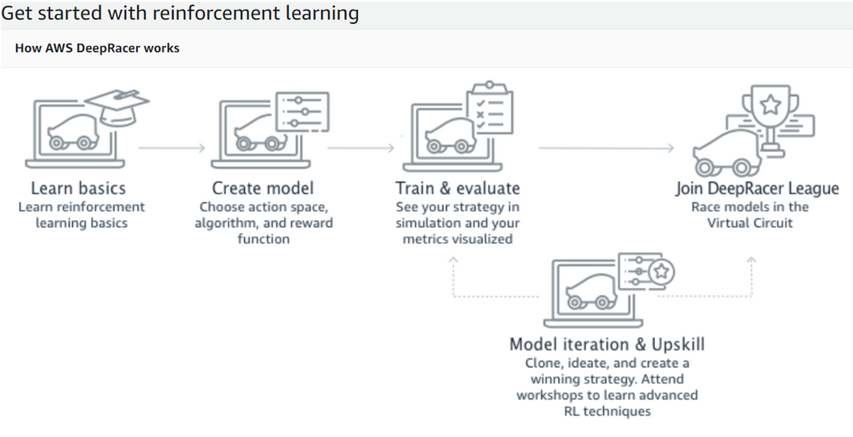
flow chart
亞馬遜開發之網站，可讓所有開發人員以強化學習模擬自駕賽車
Link:https://aws.amazon.com/tw/deepracer/

Slide 3
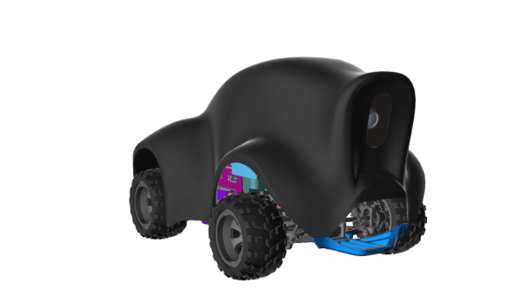
ABOUT DEEPRACER
01
A COURSE ON REINFORCEMENT LEARNING
02
CREATE A MODEL
03
MODEL NAME AND ENVIRONMENT SPECIFYING
CHOOSE RACING TYPE AND TRAINING ALGORITHM
DEFINITION OF ACTION SPACE
VEHICLE
COSTOMIZE REWARD FUNCTION

Slide 4
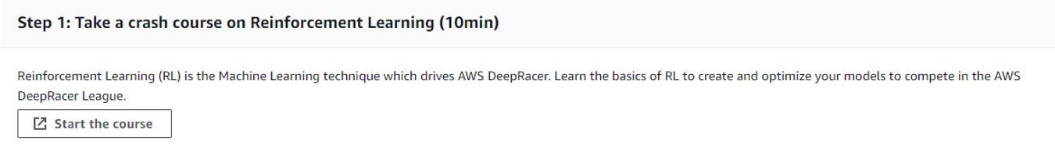
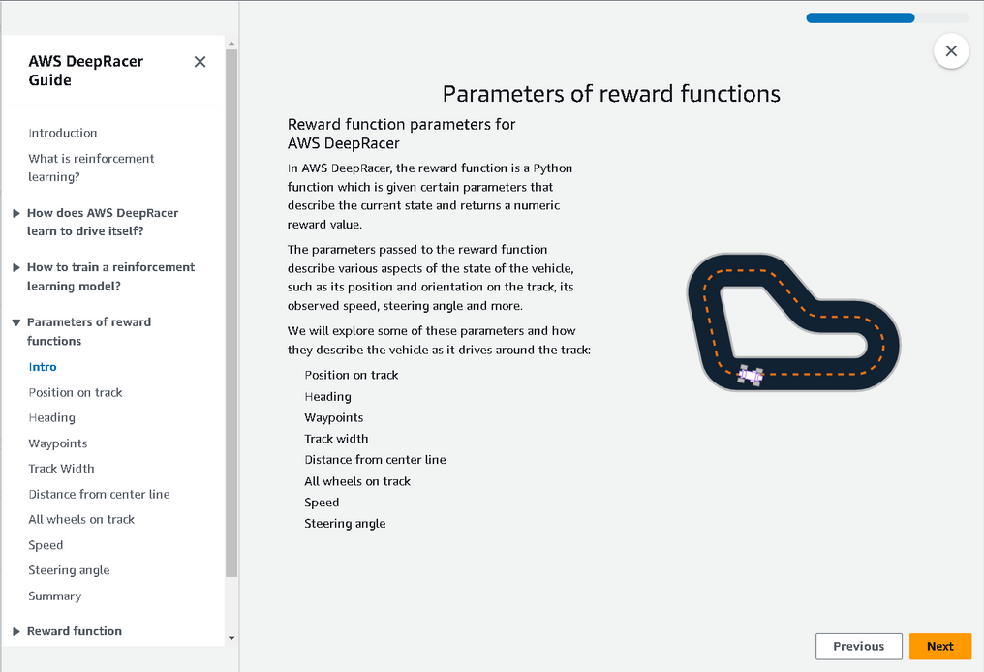
A COURSE ON REINFORCEMENT LEARNING

Slide 5
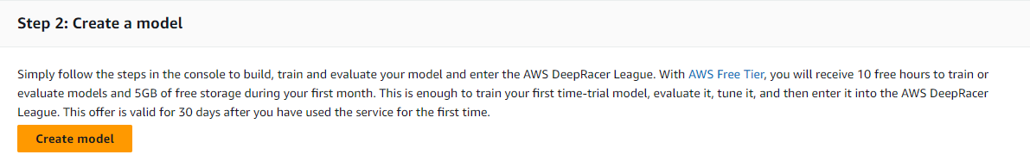
CREATE A MODEL

Slide 6
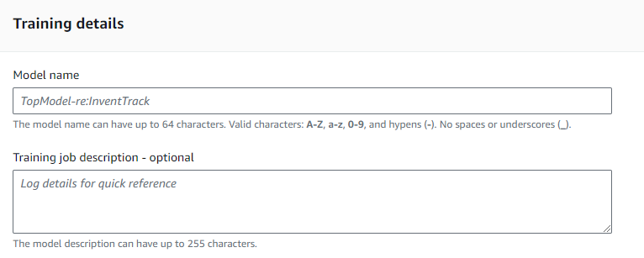
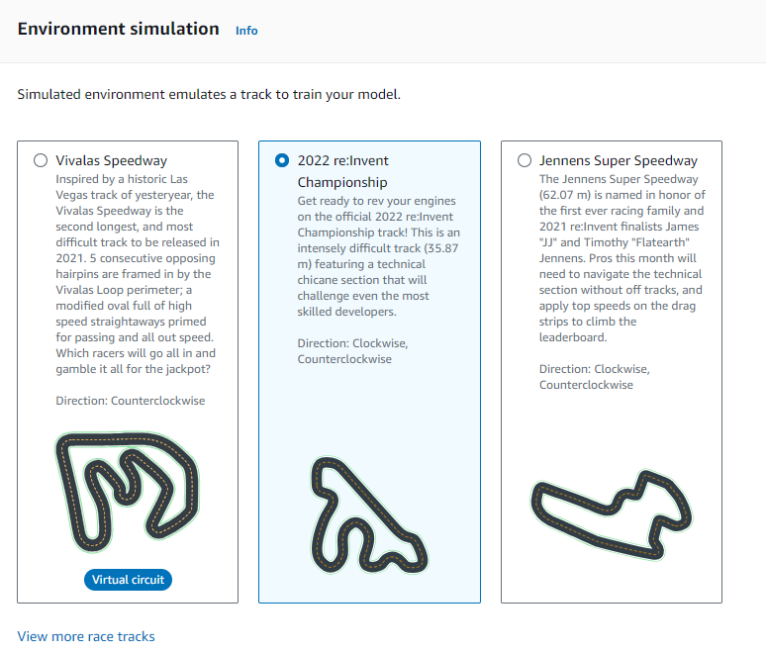
MODEL NAME AND ENVIRONMENT SPECIFYING

Slide 7
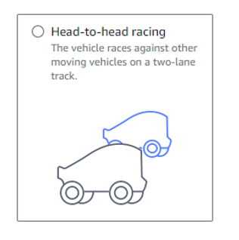
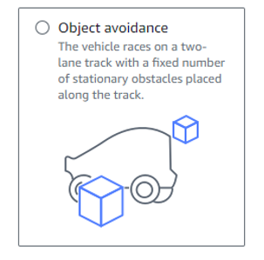
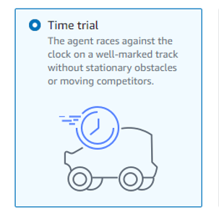
CHOOSE RACING TYPE

Slide 8
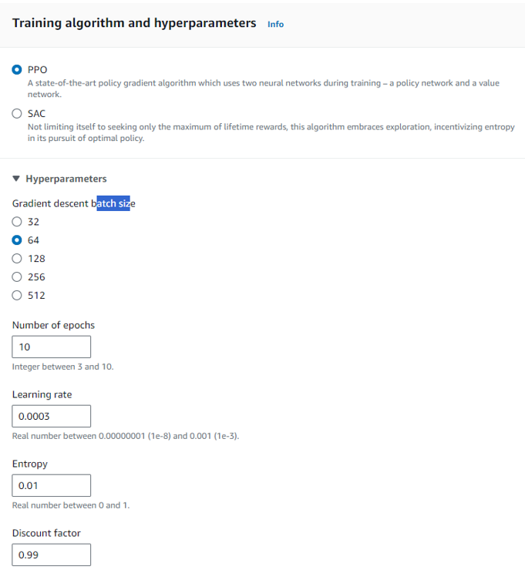
TRAINING ALGORITHM

Slide 9
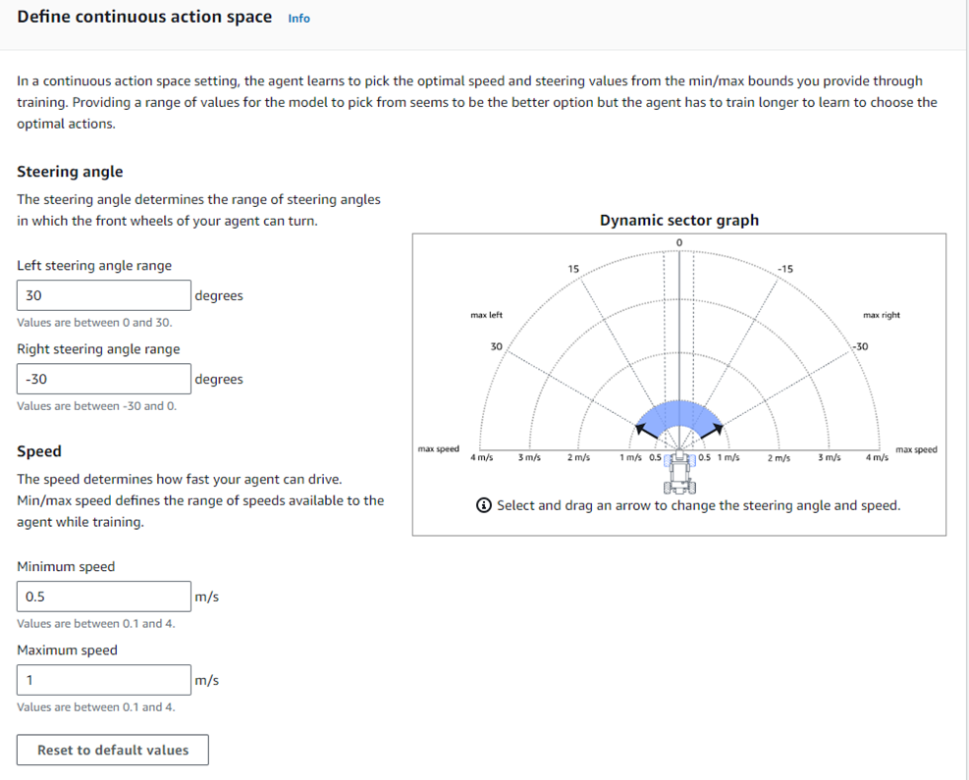
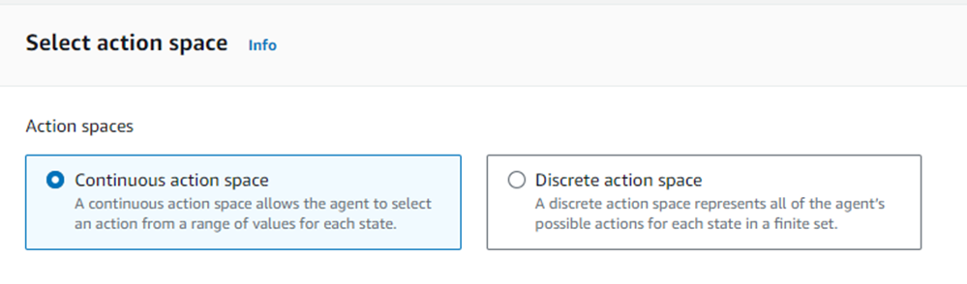
DEFINITION OF ACTION SPACE

Slide 10
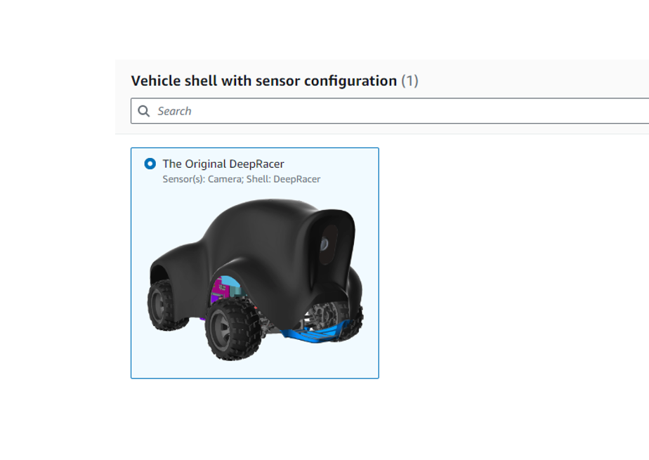
VEHICLE

Slide 11
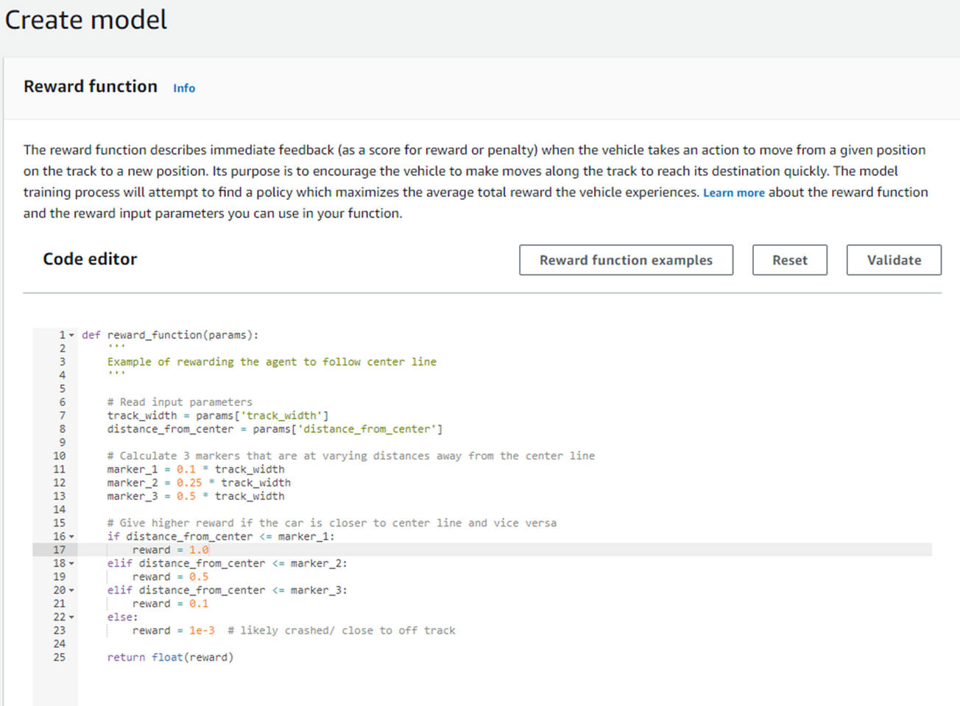
COSTOMIZE REWARD FUNCTION

Slide 12
參考網址:
https://engineering.linecorp.com/zh-hant/blog/aws-deepracer-2019
https://us-east-1.console.aws.amazon.com/deepracer/home?region=us-east-1#createModel

Slide 13
Home
Service
About Us
Contact
DEEP RACER
CREATE MODEL
4109053049 張康磊
4110053037 王盈穎

Slide 14
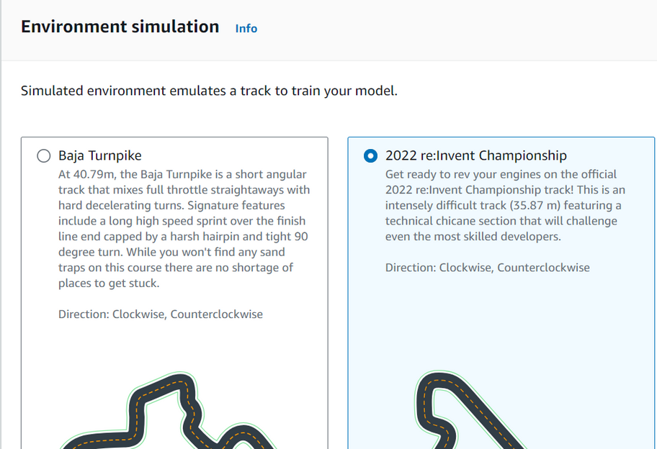
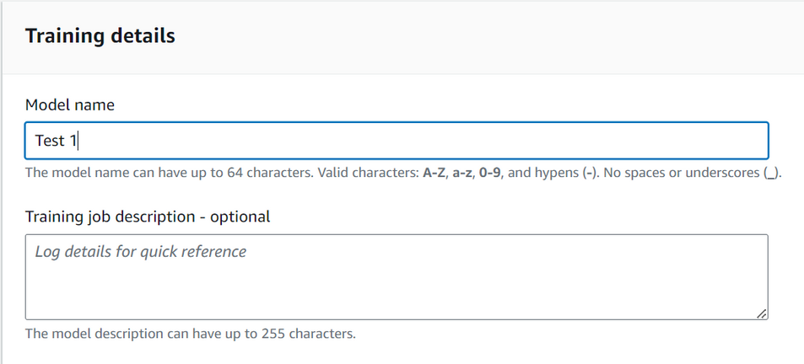
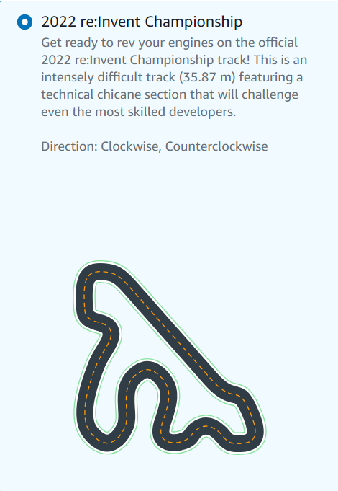

Slide 15
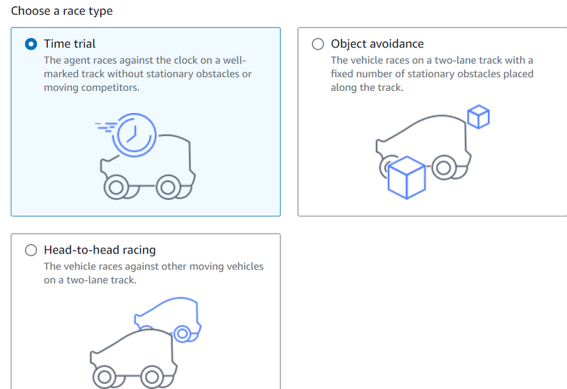
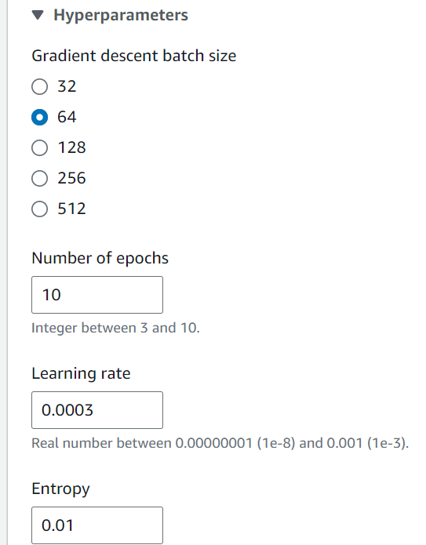
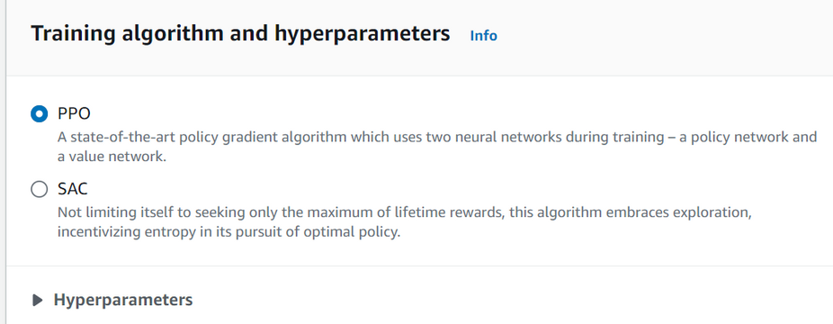
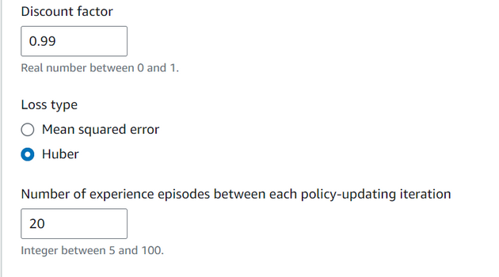
PPO:policy on
SAC: policy off

Slide 16
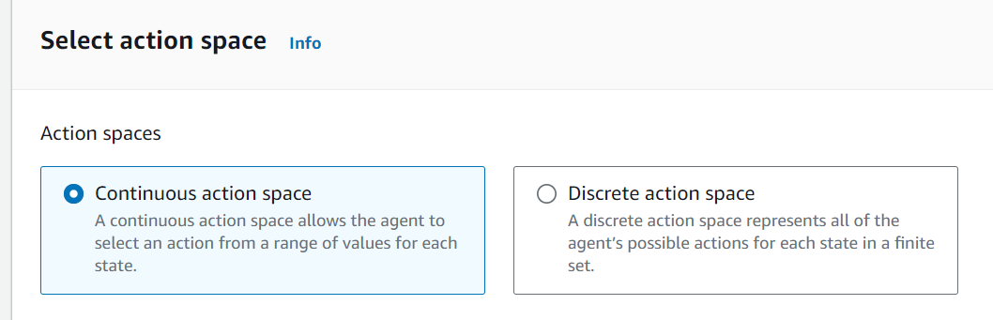
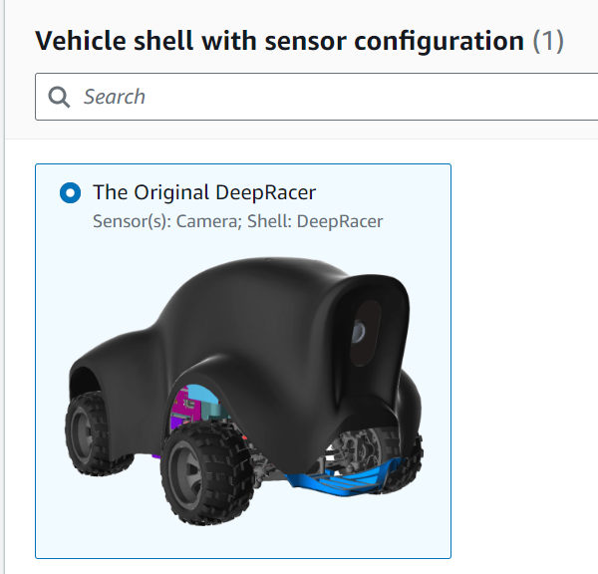

Slide 17
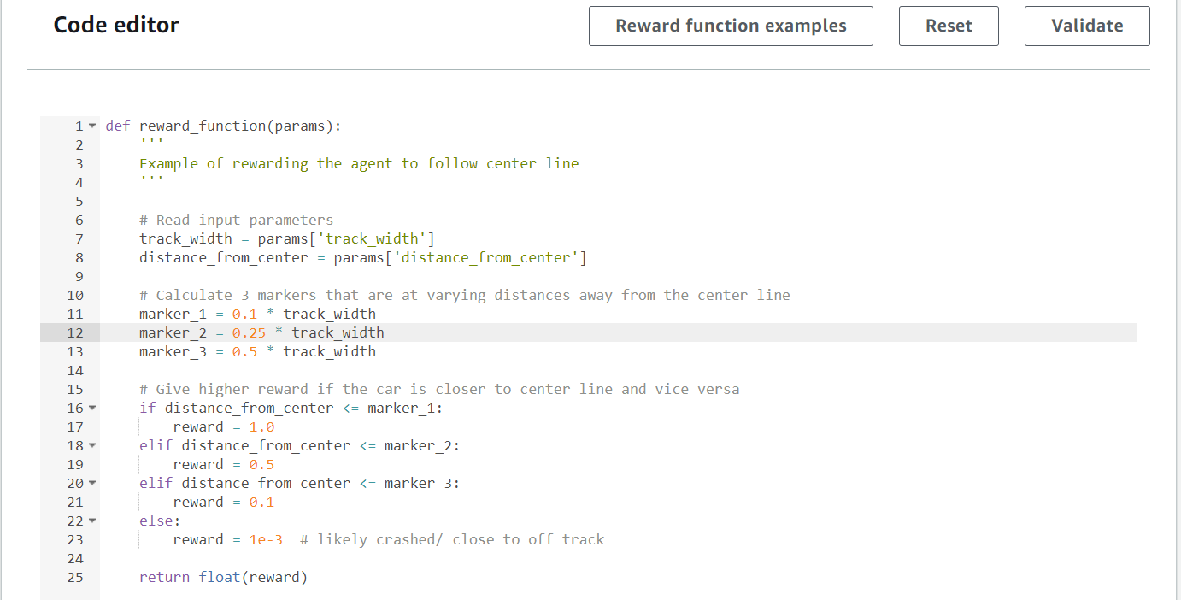
reward function design

Slide 18
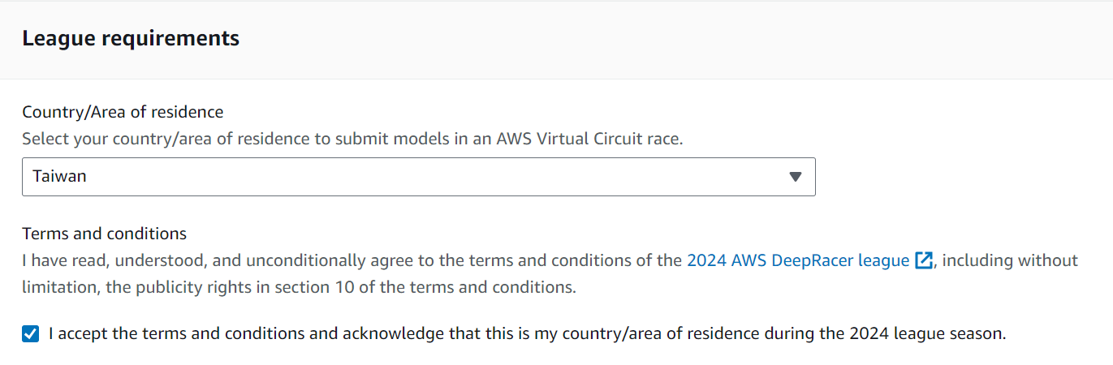
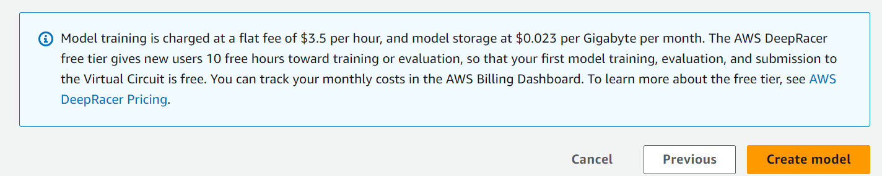

Slide 19
